Slide 1

Prepared by The Keermada Fan Club
Adversarial Attacks
22 March, 2025

Slide 2
Team Members
K Rithwin
Ritesh Baviskar
Aaditi Agrawal
220537
220286
220006
Aditya Jagdale
Piyush Patil
Ayush Meena
220470
220759
220268

Slide 3
What are Adversarial attacks?
Simply put, the adversarial attack is a deceiving technique that is “fooling” machine learning models using a defective input. Adversarial machine learning is aimed to cause a malfunction of an ML model.
Adversarial attacks become possible because of inaccurate or misrepresenting data used during the training or using maliciously designed data for an already trained model.

Slide 4
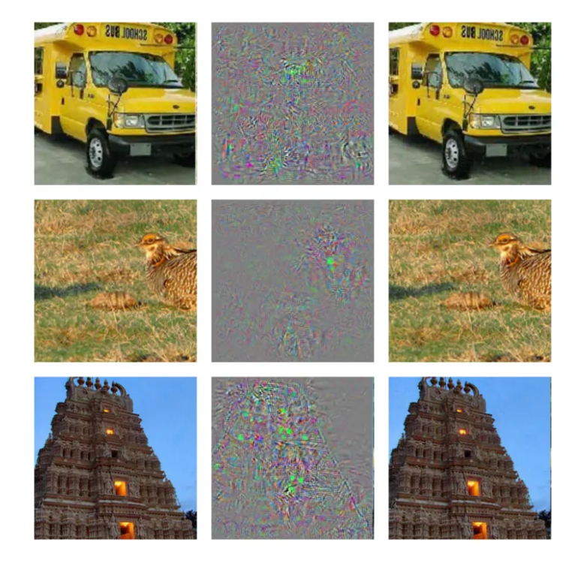
Random images in the third column are perceived as images of an an Ostrich by the ML model. The images in the middle are examples of adversarial perturbation i.e., noise added to the clean image in the first left column to create adversarial examples.

Slide 5
Various attack models aim to find a small perturbation δ to add to a legitimate input x, creating an adversarial example x̃ = x + δ. The ∞-norm of δ is kept small to remain undetectable. Attacks fall into two categories: black-box (limited knowledge of the model) and white-box (full access to the model).
White Box Attacks:
Knowledge: Full access to model architecture, weights, and gradients.
Example: FGSM, PGD.
Black Box Attacks:
Knowledge: No internal model details; relies on input-output queries.
Example: Transfer attacks (use surrogate models).

Slide 6
Few types of Whitebox Attacks
FGSM (Fast Gradient Sign Method):
Uses model gradients to create perturbations in one step.
PGD (Projected Gradient Descent):
Iterative FGSM with constraints to ensure valid inputs.
C&W (Carlini & Wagner):
Optimizes perturbations to minimize detection.
Adversarial Patches:
Physical stickers/patches added to objects (e.g., misleading road signs).
Visual: Icons or diagrams for each attack type.

Slide 7
PROBLEM STATEMENT
TRANSFORMING ADVERSARIAL SAMPLES INTO CLEAN SAMPLES

Slide 8
Literature Review

Slide 9
Paper | Method Used | Scope of Improvement
Versatile Defense Against Adversarial Attacks on Image Recognition | The approach uses a conditional GAN with a combined loss: adversarial for training GAN, pixel-wise loss for structure, and perceptual (VGG19) for semantics. Training prioritizes perceptual loss (epochs 0–39) before shifting to pixel details (epochs 40–99) and includes adversarial examples from multiple attack methods (FGSM, PGD, C&W, etc). | Adaptive Loss Weighting Experiment with Enhanced GANs Gradually increase attack strength and diversity during training.
Diffusion Models for Adversarial Purification | Forward Diffusion: Adds controlled noise via a forward SDE to remove adversarial perturbations while preserving semantics. Reverse Denoising: Uses a reverse SDE with a learned score function to restore a clean image.. | Struggle with color-based adversarial perturbations. Combining diffusion purification with adversarial training or input transformations
Defense-GAN: Protecting classifiers against adversarial attacks using generative models | Training: A GAN learns the distribution of clean images, mapping latent vectors to realistic images. Inference: Defense-GAN optimizes a latent vector via gradient descent to reconstruct the input. Defense: Projecting adversarial images onto the GAN’s distribution removes perturbations, improving robustness. | Limitations: Struggles on complex datasets. Excessive GD iterations may retain adversarial noise, and MSE-based detection is less effective for small perturbations. Improvements: Use deeper GANs, integrate statistical anomaly detection
Detecting and Classifying Adversarial Examples Based on DCT Transform | This method uses Discrete Cosine Transform (DCT) to detect adversarial perturbations by analyzing frequency differences, with an SVM classifier distinguishing attacks. Combining DCT with attention mechanisms (CBAM) enhances attack classification, while an integrated framework ensures robust detection and deeper insights into adversarial strategies. | The approach is effective against known attacks but lacks evaluation against adaptive threats targeting DCT-based defenses. Integrating adaptive mechanisms, such as online learning, could enhance resilience to evolving attacks.

Slide 10
Paper | Method Used | Scope of Improvement
Towards Adversarial Purification using Denoising AutoEncoders | AutoEncoders (AE) compress and reconstruct data, while Denoising AutoEncoders (DAE) remove noise, restoring adversarial samples to their clean versions. APuDAE iteratively refines inputs to minimize reconstruction error, prevents direct attacks on purification, and uses skip connections to retain essential features while removing noise. | Computational Overhead – Requires multiple purification iterations, increasing inference time. Limited to White-Box Attacks – The study does not evaluate performance against black-box attacks. Potential Image Quality Loss – While it removes adversarial noise, some fine image details may also be lost.
Feature Squeezing: Detecting Adversarial Examples in Deep Neural Networks | Bit-Depth Reduction: Lowers pixel bit depth (e.g., 8-bit → 4-bit→ 2-bit) to remove adversarial noise while preserving key features. Spatial Smoothing: Uses median filtering and non-local means to reduce pixel-level noise and smooth perturbations. Detection via Prediction Comparison: Identifies adversarial intent by comparing predictions on original and squeezed inputs. | Predefined bit-depth and smoothing filters may not be optimal instead implement learnable feature squeezing to adapt dynamically. Aggressive squeezing can lower accuracy on clean inputs, use adaptive squeezing based on input characteristics instead of fixed thresholds.
Adversarial Examples Detection in Deep Networks with Convolutional Filter Statistics | Feature Extraction: Uses PCA coefficients, min/max values, and percentiles to detect adversarial deviations while resisting gradient-based attacks. Cascade Classifier: Early layers discard obvious normal examples, while deeper layers refine detection using SVM classifiers trained on adversarial and normal examples. | GAN-based adaptive defense and evaluation on datasets like CIFAR and MNIST enhance detection and generalization. Feature pruning, improved CNN receptive fields, and combined adversarial training with certified defenses bolster real-world robustness.
Ensemble Learning Methods of Adversarial Attacks and Defenses in Computer Vision | AI in computer vision is vulnerable to adversarial examples, where small perturbations deceive models. Ensemble learning enhances both attacks and defenses through parallel, sequential, and hybrid methods. Attack strategies improve transferability and refinement, while defenses use multiple models or iterative processing to counter adversarial noise effectively. | Ensemble models are computationally expensive, struggle with attack transferability, and may reduce clean data performance. Future work should focus on optimizing efficiency, dynamic model integration, diverse defenses, hybrid approaches, and explainable AI to enhance robustness and adaptability.
AutoEncoders (AE) compress and reconstruct data, while Denoising AutoEncoders (DAE) remove noise, restoring adversarial samples to their clean versions. APuDAE iteratively refines inputs to minimize reconstruction error, prevents direct attacks on purification, and uses skip connections to retain essential features while removing noise.

Slide 11
Paper | Method Used | Scope of Improvement
Defense against Adversarial Attacks Using High-Level Representation Guided Denoiser | The paper proposes a high-level representation guided denoiser (HGD) to counter adversarial attacks by aligning feature representations instead of pixel differences. It introduces three variants—FGD, LGD, and CGD—evaluated on ImageNet against attacks like FGSM, showing improved robustness across models. | Residual noise remains due to transformation limitations, with training focused on a narrow range of attacks and ImageNet. Improvements include diversifying attack types, balancing pixel-feature alignment, creating an end-to-end optimization framework, and expanding evaluations to broader datasets.
Robust Image Classification: Defensive Strategies against FGSM and PGD Adversarial Attacks | The convolutional autoencoder reconstructs clean images from adversarial inputs using a GELU-activated encoder, latent space regularization with Gaussian noise, and a transposed convolutional decoder. Adversarial examples are generated using FGSM and PGD attacks, and the autoencoder is trained with MSE loss to restore original images, while VGG16 is trained separately on clean data. | The autoencoder defense is computationally expensive and untested on complex datasets or advanced attacks like CW. Fine-tuning is needed for different scenarios, and reconstruction may impact accuracy. Improvements include model compression, adaptive mechanisms, automated tuning, and broader evaluations for better scalability and robustness.
Explanations can be manipulated and geometry is to blame | This work addresses neural networks' vulnerability to curved decision boundaries by proposing β-smoothing with Softplus instead of ReLU for more robust explanations. Unlike ReLU, which creates sharp decision regions, Softplus provides smoother transitions, reducing abrupt cutoffs and enhancing interpretability. | β-smoothing stabilizes explanations but may reduce sensitivity, potentially losing fine details in critical applications like medical imaging. Further research is needed to evaluate its effectiveness against decision-based, black-box, and data poisoning attacks.
Adversarial Attacks on Image Classification Models: Analysis and Defense | FGSM: Perturbs pixels along the gradient of the loss function. Adversarial Patch Attack: Overlays a small patch to mislead labels. Defensive Distillation: Uses a 2-step training process—training a teacher model with high-temperature softmax and a student model on soft labels for robustness. | Limitation: Not Effective against stronger attacks like PGD, C&W. Training both Teacher and Student Model is computationally expensive. Improvement: Combine distillation with adversarial training to improve generalization.

Slide 12
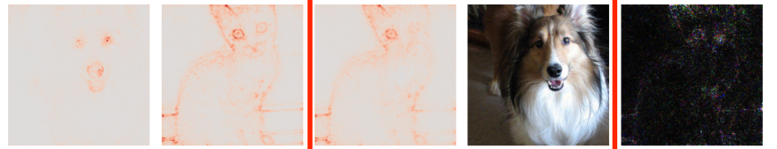
Findings from literature review
Purification models are computationally expensive so it is not practically feasible to purify all samples in a dataset
A purification model needs to be robust against a variety of attacks not just for specific attack types.
Effective purification model should not only remove noise but also preserve the high-level semantic features that affect the explanation map of the classifier
Explanation map (encodes the relevance score of each pixel for the neural network’s prediction) can be modified
Original explanation map
Target explanation map
Modified explanation map
Original image
Perturbations

Slide 13

PROPOSED MODEL
Detector-purifier submodule
Sample
Adversarial detector
positive
Adversarial purifier
negative
Pretrained classifier
Output prediction

Slide 14
Detector-purifier submodule
Detector :
An adversarial attack detector submodule that will detect if a given sample is adversarial or not with a confidence score. If the sample is classified as adversarial, it will be forwarded to the adversarial purifier. Experimentations need to be done to select an adversarial detector model that performs the best(feature squeezing, DCT Transform-Based Detector, or ensemble of techniques)
Adversarial purifier:
Suppose the detector reports a high probability of a sample being adversarial. In that case, it will be sent to the purifier submodule, which will convert it to a clean sample(that is non-adversarial). Variational autoencoder, GANs, Diffusion models etc(the best one will be found after experimentations) will take the adversarial image as input and will learn to reconstruct the clean image.

Slide 15
Addition of Perceptual loss to the purification model objective: Perceptual loss involves comparing the high-level features of the purified and target images rather than comparing pixel values directly. This ensures that the semantic features of the original image are preserved
Use of training dataset consisting of multiple type of adversarial samples (FGSM, PGD, C&W etc) to ensure robustness of the detector and the purifier
Pretrained classifier : Experimentations will be done using various pretrained image classifiers such as InceptionNet, VGG16 etc to test the effectiveness of the detector-purifier submodule.

Slide 16
Deliverables and Conclusion
The final deliverable will consist of a model designed to detect and transform adversarial samples into non-adversarial ones. Additionally, the deliverables will include the experimental results demonstrating the effectiveness of the model.

Slide 17
Timeline
Problem definition & literature review
Baseline Model & Attack Generation
Internal Testing & fine- tuning
Feedback Incorporation
Final Submission
21-26 Mar
2-8 Apr
17-19 Apr
21-22 Apr
15-20 Mar
27 Mar-1 Apr
9-16 Apr
20 Apr
23 Apr
Dataset & Preliminary Experiments
Improved Model Development
Final Project Presentation & Demo
Final Project Code Review

Slide 18
Contributions
All the members of the group have contributed equally.

Slide 19
Thank you

